Slide 1
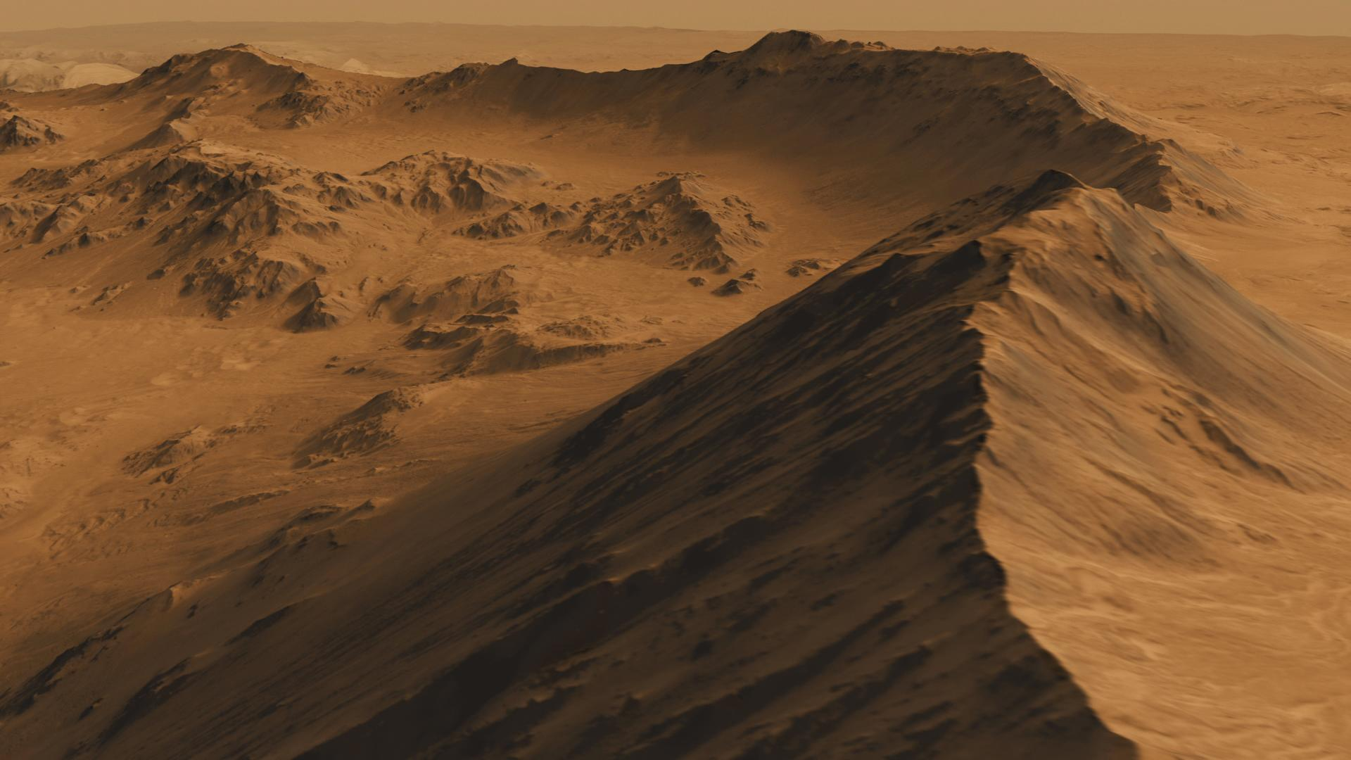
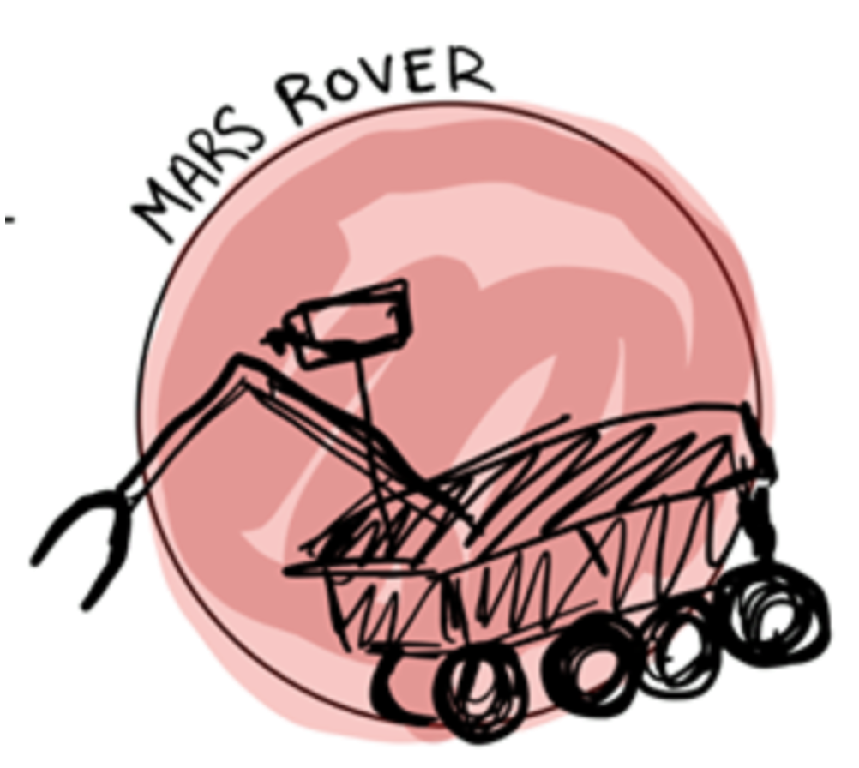
Autonomous Navigation
By Team 28 | ECE Department
Linden Vo
Tommy Lam
Daniel Crawley
Brian He
Kelly Lee
Notes:
https://www.jpl.nasa.gov/spaceimages/details.php?id=PIA17447

Slide 2
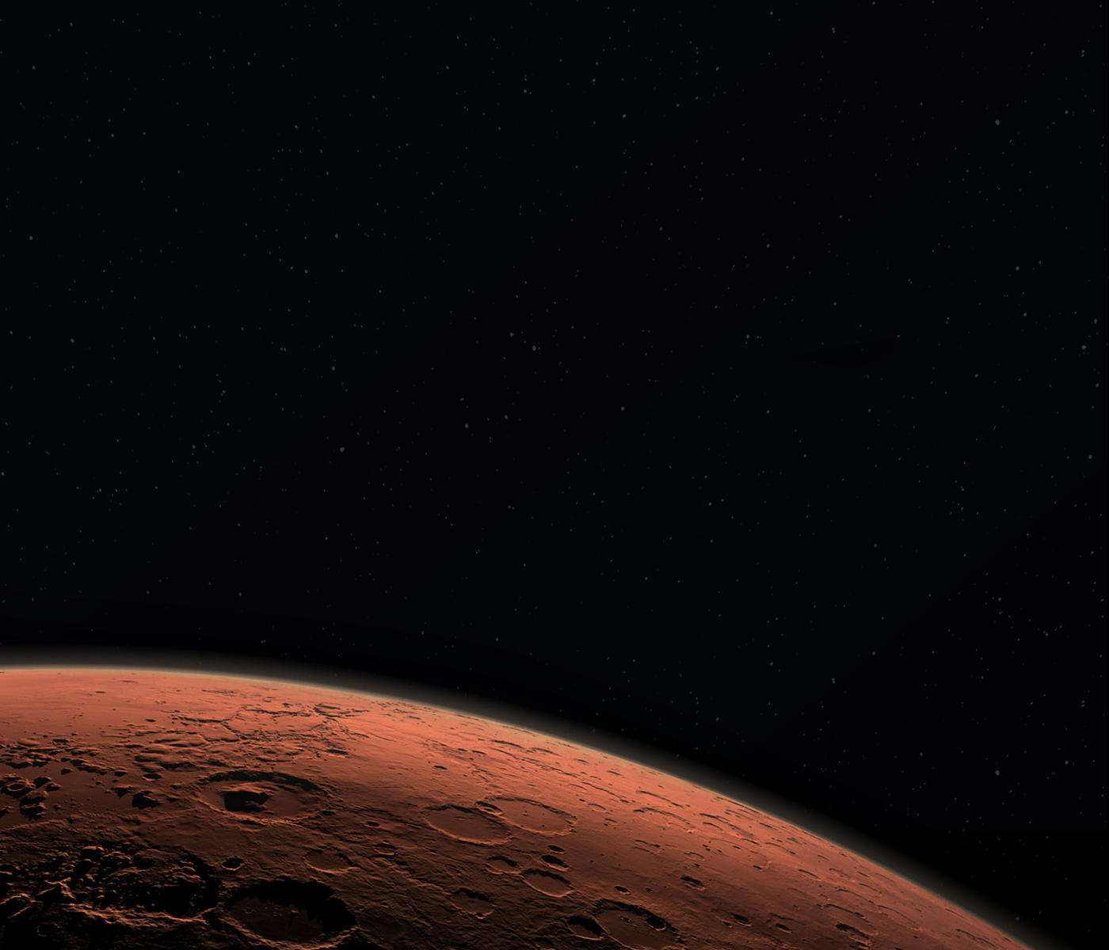
Our Goal
Design and build a rover capable of autonomously traversing Mars-like terrain using visual and inertial navigation
Notes:
https://mars.jpl.nasa.gov/resources/4845/high-resolution-self-portrait-by-curiosity-rover-arm-camera/?site=msl bottom picture

Slide 3
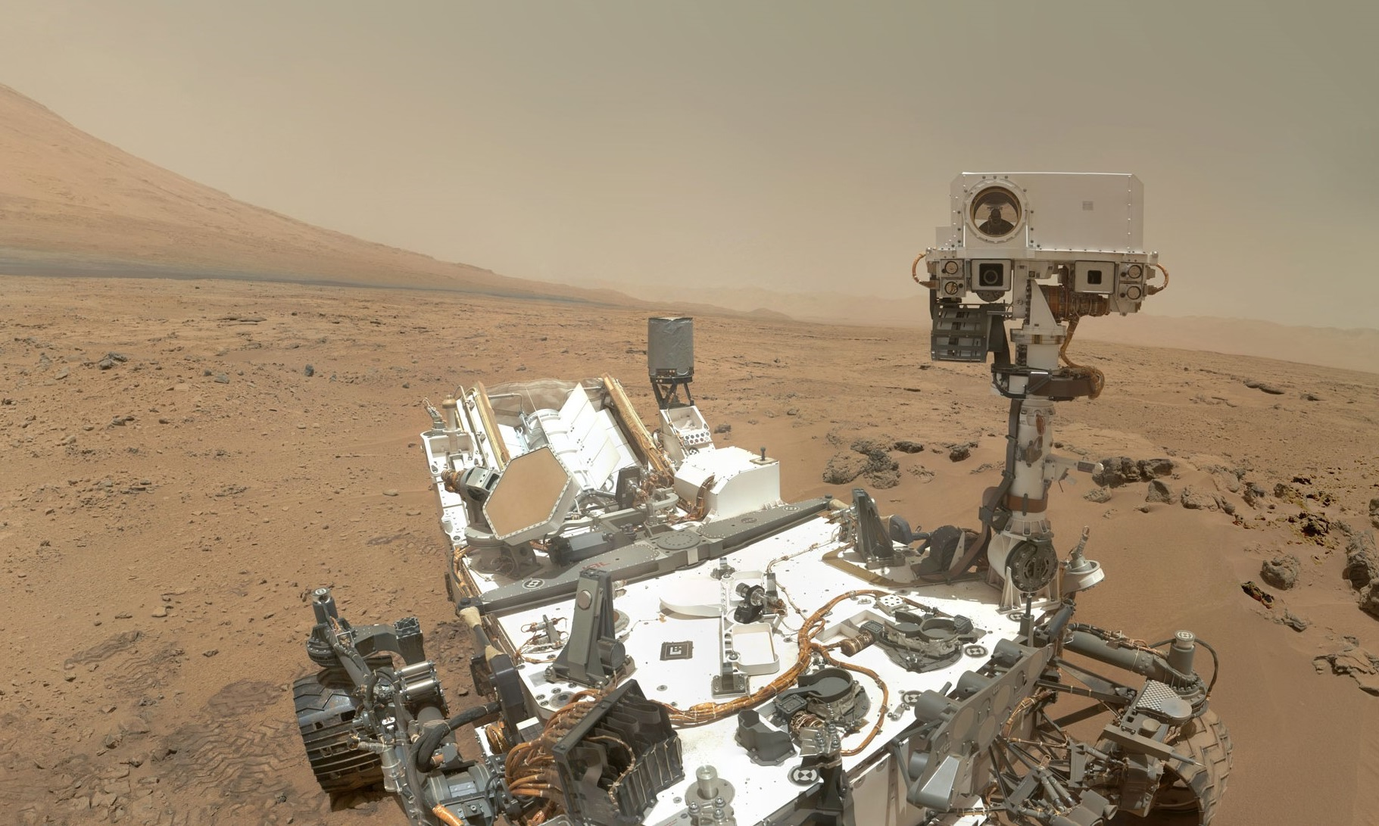
Capabilities
Given a GPS coordinate, the rover will drive itself to that coordinate
The rover will be able to navigate around obstacles blocking its path
It also will be able to drive between two posts that are 5m apart
Lastly, the rover will be able to detect an AR tag on a post and navigate towards it
Notes:
Poifect
https://mars.jpl.nasa.gov/resources/4845/high-resolution-self-portrait-by-curiosity-rover-arm-camera/?site=msl

Slide 4
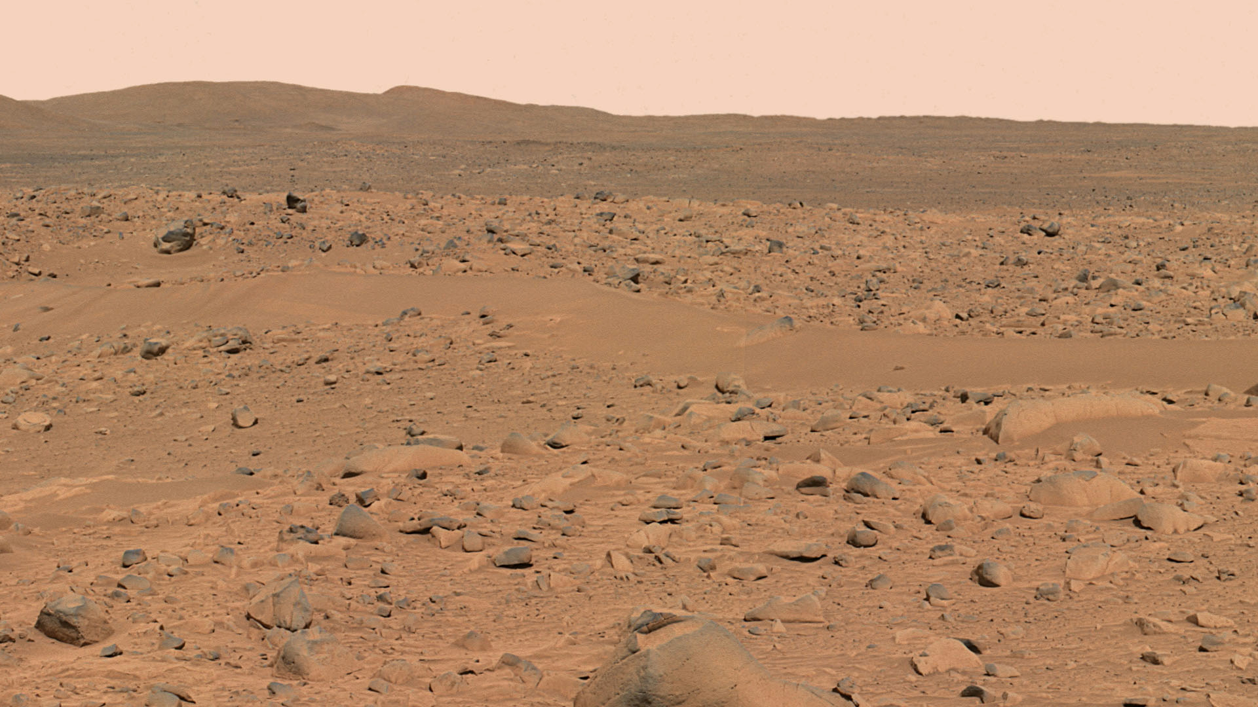
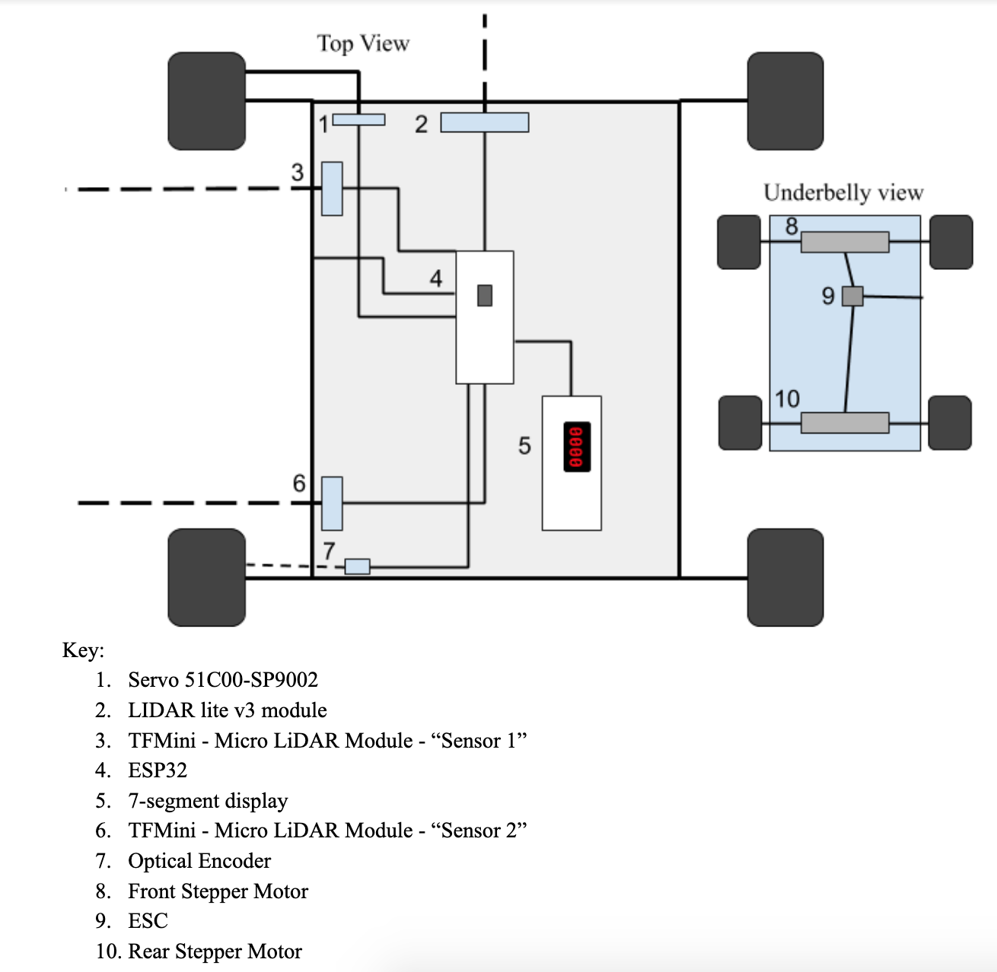
Notes:
https://mars.jpl.nasa.gov/mer/gallery/press/spirit/20040318a/10-JG-04-hills-A074R1.jpg

Slide 5
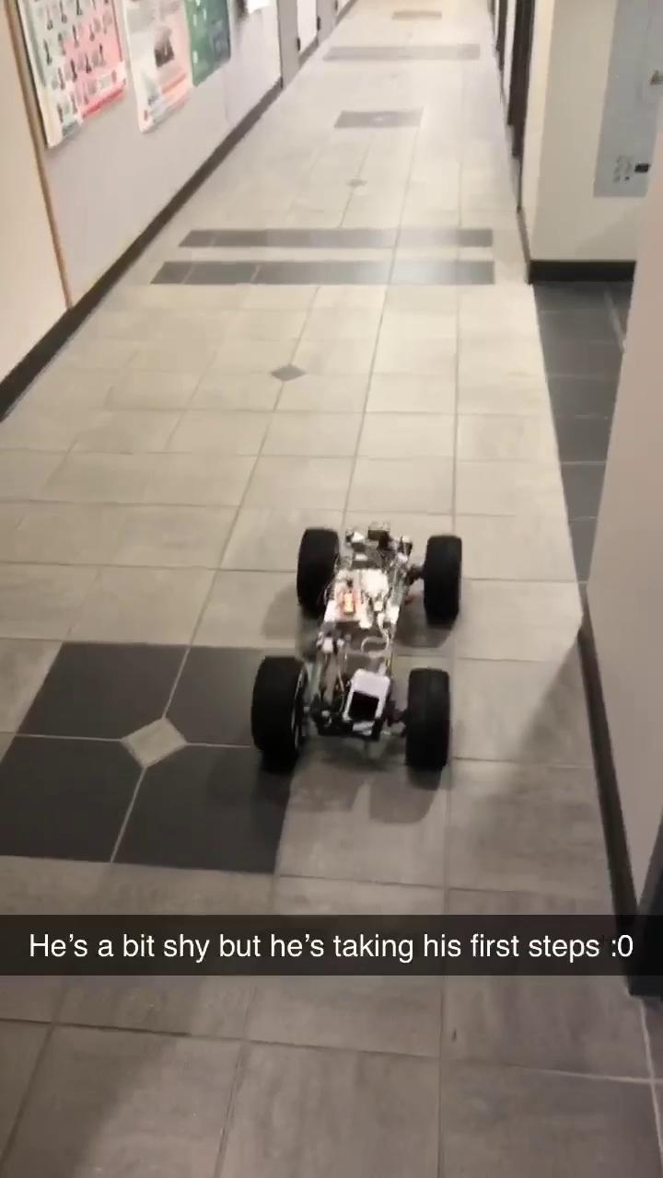

Slide 6
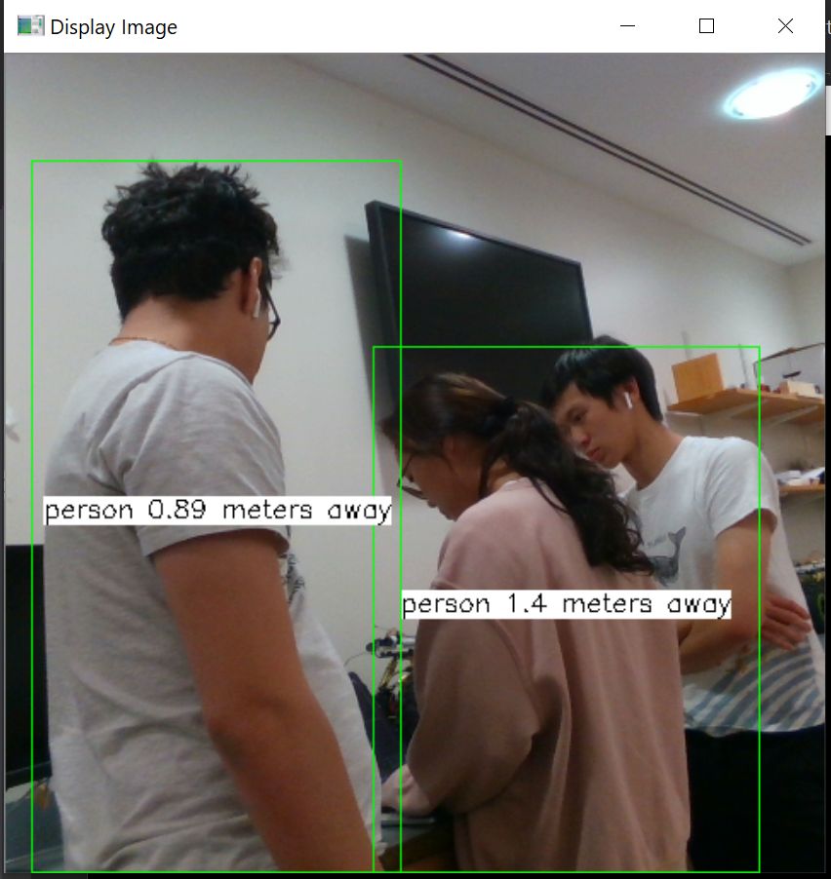
Intel RealSense
Object Recognition
Distance Sensing

Slide 7
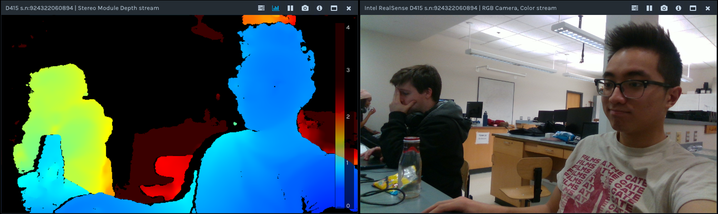
Intel Realsense

Slide 8


Slide 9
Next Steps
Interface Jetson TX2 with ESP32
Think about weather conditions on Mars and how to best keep stable temperatures on the Rover
Simulate Mars-like weather conditions on the Rover in testing
Consider different power supplies and trade-offs
Notes:
https://mars.nasa.gov/internal_resources/584/

Slide 10
Thank you!

